Slide 1
DMS 201 : Introduction to Management Module-II: Financial Management Dr. Parvati Neelakantan

Slide 2
PART 1: BUSINESS ENVIRONMENT Lecture 8: How to Calculate Present Values

Slide 3
Topics Covered
Future Values and Present Values.
Looking for Shortcuts—Perpetuities and Annuities.
More Shortcuts—Growing Perpetuities and Annuities.
How Interest Is Paid and Quoted.
3

Slide 4
Present Value and Future Value
Future Value.
Amount to which an investment will grow after earning interest.
Compound Interest.
Interest earned on wealth that grows at a compound rate.
Present Value.
Value today of a future cash flow.
4

Slide 5
Future Values
Example: F V
What is the future value of $100 if interest is compounded annually at a rate of 7% for 2 years?
Notice that in the second year you earn interest on both your initial investment ($100) and the previous year’s interest ($7). Thus, your wealth grows at a compound rate and the interest that you earn is called compound interest.
5

Slide 6
Future Values
Future Value of $100 = F V
If you invest your $ 100 for t years, your investment will continue to grow at 7% compound rate to
6

Slide 7
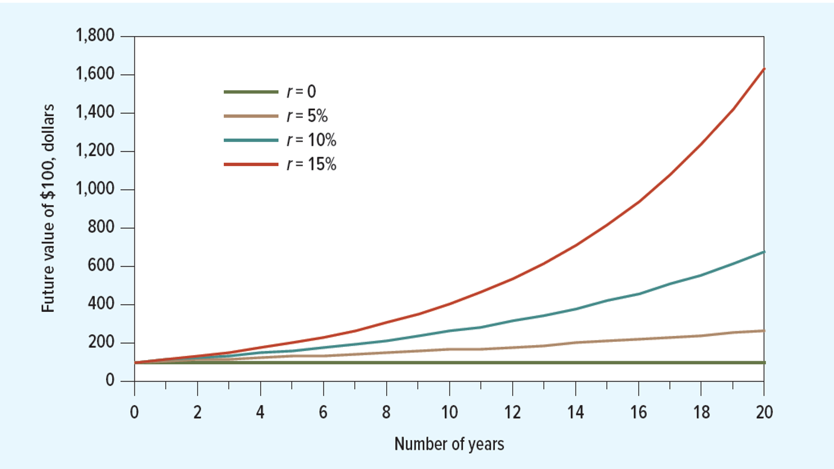
Future Values With Compounding
How an investment of $100 grows with compound interest
The higher the interest rate, the faster your savings will grow.
7

Slide 8
Present Value
The P V formula has many applications. Given any variables in the equation, you can solve for the remaining variable. Also, you can reverse the prior example.
8

Slide 9
Present Value
Present value = P V
The rate, r, in the formula is called the discount rate.
9

Slide 10
Present Value
Discount factor = D F = P V of $1
Discount factors can be used to compute the present value of any cash flow.
Discount factor measures the present value of one Rs/$ received at the end of year t.
DF2=1/(1.07)^2=0.8734 => Investors are willing to pay $0.8734 today for delivery of $1 at the end of 2 years.
10

Slide 11
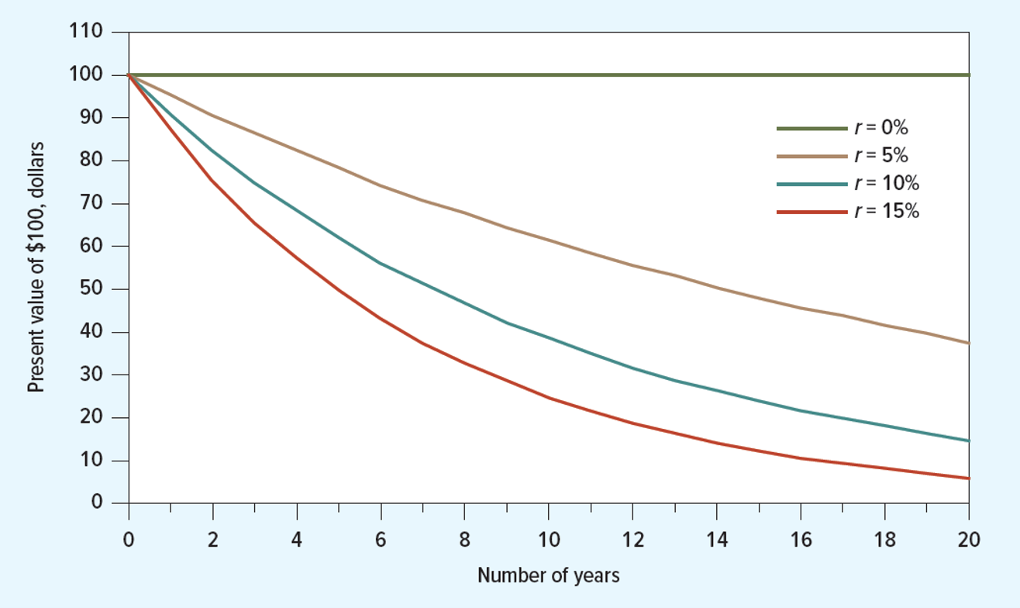
Present Values With Compounding
Present value of a future cash flow of $100. Notice that the longer you have to wait for your money, the less it is worth today.
Notice how small variations in the interest rate can have a powerful effect on the PV of the distant cashflows.
11

Slide 12
Valuing an Investment Opportunity
Suppose cost of buying the land and constructing the building is $700,000. Your company has cash in the bank to finance construction.
Step 1: Forecast cash flows.
Step 2: Estimate opportunity cost of capital.
If equally risky investments in the capital market offer a return of 7%, then
Cost of capital = r = 7%
12

Slide 13
Valuing an Investment Opportunity : How much is the investment worth and how much will it add to your shareholders’ wealth?
Step 3: Discount future cash flows.
Step 4: Go ahead if P V of payoff exceeds investment.
13

Slide 14
Net Present Value
14

Slide 15
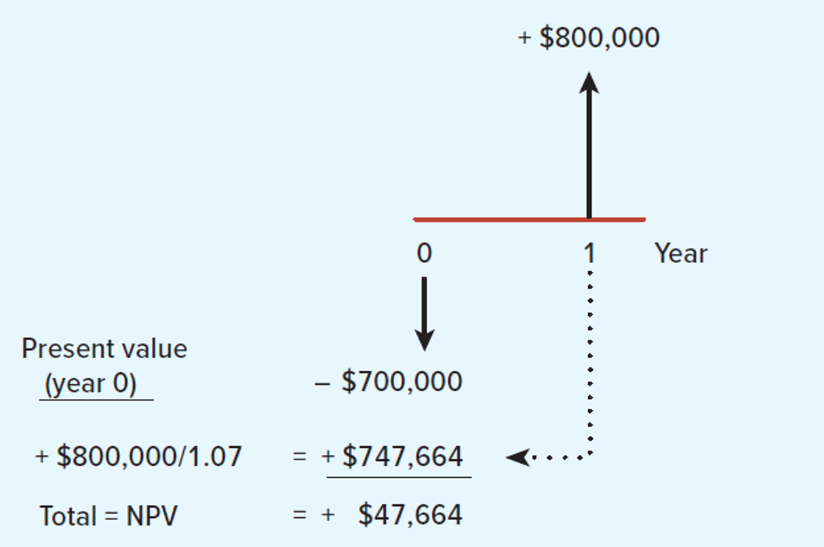
N P V Calculation
15

Slide 16
Risk and Present Value
Higher-risk projects require a higher rate of return
Higher required rates of return cause lower PVs
16

Slide 17
Risk and Net Present Value
17

Slide 18
Net Present Value Rule
Accept investments that have positive net present value.
Example
Use the original example. Should we accept the project given a 10% expected return?
18

Slide 19
Rate of Return Rule
Accept investments that offer rates of return in excess of their opportunity cost of capital.
Example
In the project listed below, the foregone investment opportunity is 12%. Should we do the project?
19

Slide 20
Decision Rule
Net present value rule: Accept investments that have positive net present value.
Rate of return rule: Accept investments that offer rates of return in excess of their opportunity cost of capital.

Slide 21
Calculating Present Values When There Are Multiple Cash Flows
For multiple periods we have the discounted cash flow (D C F) formula.
21

Slide 22
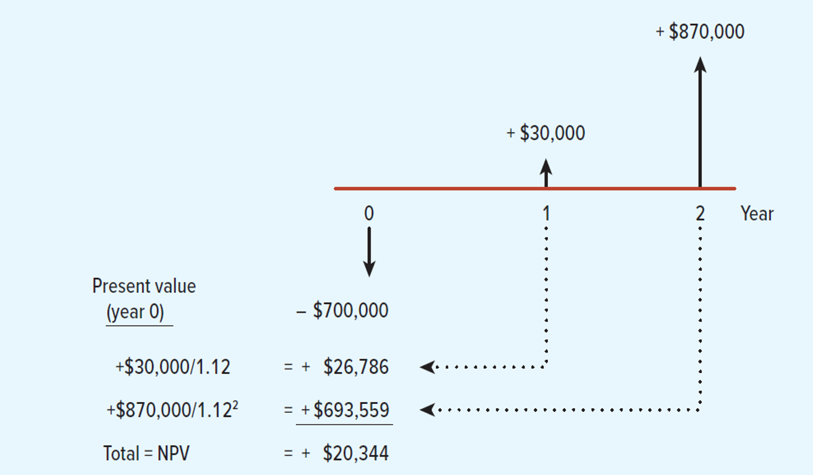
N P V Calculation
22

Slide 23
How to Value Perpetuities
Sometimes there are shortcuts that make it very easy to calculate the present value of an asset that pays off in different periods.
These tools allow us to cut through the calculations quickly.
23

Slide 24
Shortcuts
Perpetuity: Financial concept in which a cash flow is theoretically received forever.
24

Slide 25
Shortcuts
Perpetuity: Financial concept in which an evenly spaced level cash flow is theoretically received forever.
Note: Each cash flow is received at the end of the period.
25

Slide 26
Present Values
Example
What is the present value of $1 billion every year, for all eternity, if you estimate the perpetual discount rate to be 10%?
26

Slide 27
Present Values
Example
What if the investment does not start making money for 3 years (first payment received at the end of the third year)?
27

Slide 28
How to Value Annuities
Annuity: An asset that pays a fixed sum each year for a specified number of years.
28

Slide 29
Perpetuities and Annuities
P V Annuity Factor (P V A F): The present value of $1 a year for each of t years.
29

Slide 30
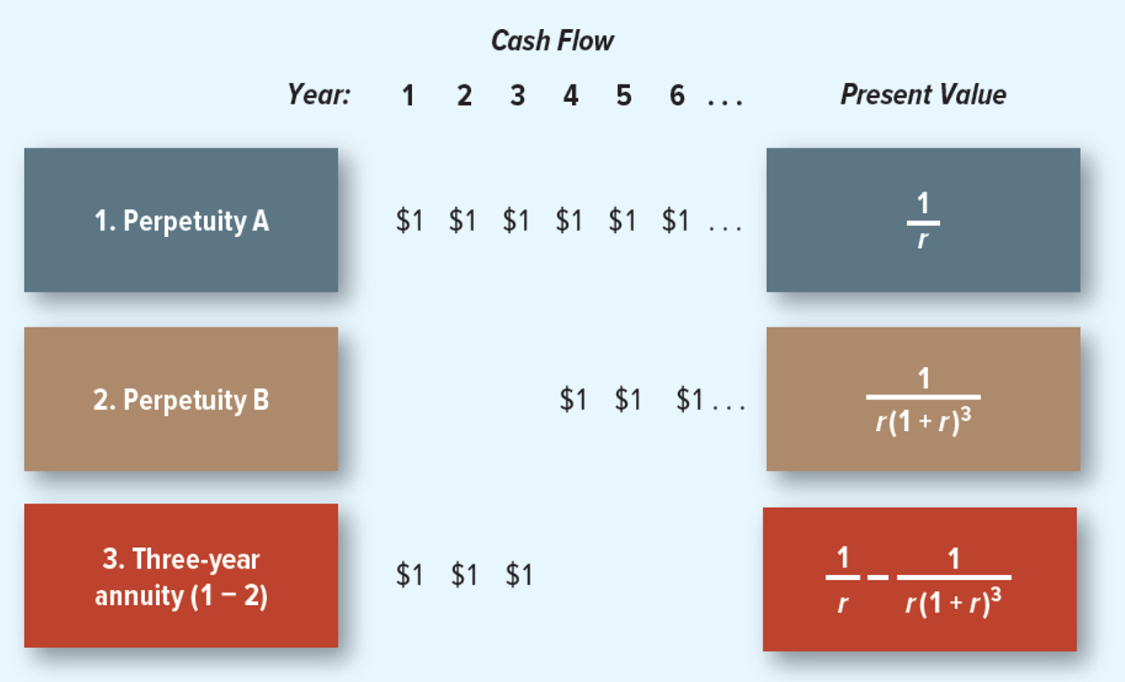
Annuity (and its relationship to perpetuities)
An annuity that makes payments in each of years 1 through 3 is equal to the difference between two perpetuities.
30

Slide 31
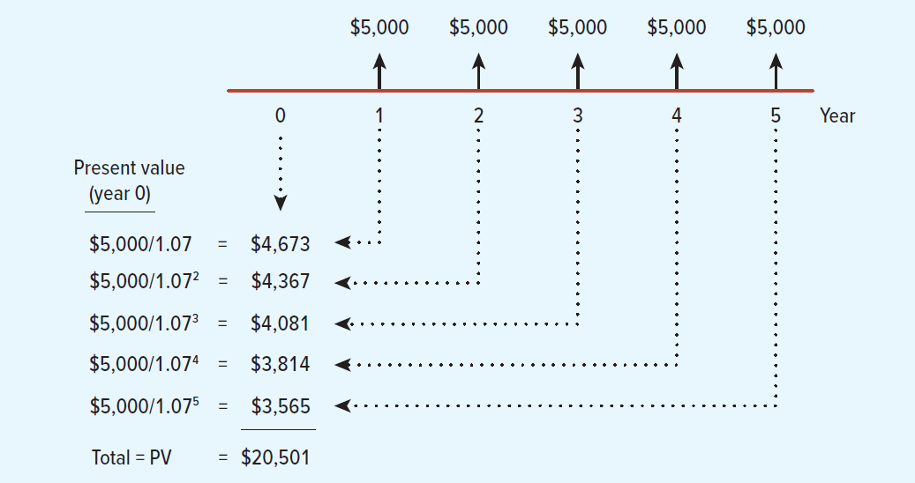
Costing an Installment Plan
31

Slide 32
Paying off a Bank Loan
Bank loans are paid off in equal installments. Suppose that you take out a -year loan of $1,000.
The bank requires you to repay the loan evenly over the four years.
It must therefore set the four annual payments so that they have a present value of $1,000.
32

Slide 33
Amortizing Loan Example
An example of an amortizing loan. If you borrow $1,000 at an interest rate of 10%, you would need to make an annual payment of $315.47 over 4 years to repay that loan with interest.
Year | Beginning-of-Year Balance | Year-End Interest on Balance | Total Year-End Payment | Amortization of Loan | End-of-Year Balance
1 | $1,000.00 | $100.00 | $315.47 | $215.47 | $784.53
2 | 784.53 | 78.45 | 315.47 | 237.02 | 547.51
3 | 547.51 | 54.75 | 315.47 | 260.72 | 286.79
4 | 286.79 | 28.68 | 315.47 | 286.79 | 0
33

Slide 34
Future Value of an Annuity
Example: Suppose you invest $429.59 annually at the beginning of each year at 10% interest. After 50 years, how much would your investment be worth?
34

Slide 35
Future Value of an Annuity
Future Value of an Annuity: The future value of an asset that pays a fixed sum each year for a specified number of years.
35

Slide 36
Future Value of an Annuity
Example
What is the future value of $20,000 paid at the end of each of the following 5 years, assuming your investment returns 8% per year?
36

Slide 37
Valuing Annuities Due
Annuity due: Level stream of cash flows starting immediately.
How does it differ from an ordinary annuity?
How does the future value differ from an ordinary annuity?
37

Slide 38
Growing Perpetuities
Present value of growing perpetuity
g = the annual growth rate of the cash flow
38

Slide 39
Growth Perpetuity Example
Example
What is the present value of $1 billion paid at the end of every year in perpetuity, assuming a rate of return of 10% and a constant growth rate of 4%?
39

Slide 40
How Interest Is Paid and Quoted
Annual Percentage Rate: Interest rate that is annualized using simple interest.
Effective Annual Interest Rate: Interest rate that is annualized using compound interest.
40

Slide 41
E A R and A P R Formulas
Effective annual interest rate: Interest rate that is annualized using compound interest.
Annual percentage rate: Interest rate that is annualized using simple interest.
Annual Percentage Rate (A P R):
Effective Annual Interest Rate (E A R):
41

Slide 42
Effective Interest Rates
Example:
Given a monthly rate of 1%, what is the annual percentage rate (A P R)? What is the effective annual rate (E A R)?
42

